Slide 1
Axial turbines

Slide 2
Table of contents
6.1. Introduction
6.2. Expansion cascade
6.3. Loss correlations: Traupel
6.4. Loss correlations: Ainley y Mathieson
6.5. Loss correlations: Soderberg
6.6. Efficiency definition

Slide 3
6.1. Introduction
This chapter is concerned with the detailed 2D analysis of axial turbines
This 2D analysis is a good approximation for low heights to radius and constrained secondary flows (sufficiently slender)
The challenge to the designer is the optimization of the turbine with insufficient details to complete the cuantitative analysis
Two possible approaches:
Start from an existing design
From zero, study velocity triangles, Smith diagram, simple correlations, experience, etc.

Slide 4
Table of contents
6.1. Introduction
6.2. Expansion cascade
6.3. Loss correlations: Traupel
6.4. Loss correlations: Ainley y Mathieson
6.5. Loss correlations: Soderberg
6.6. Efficiency definition

Slide 5
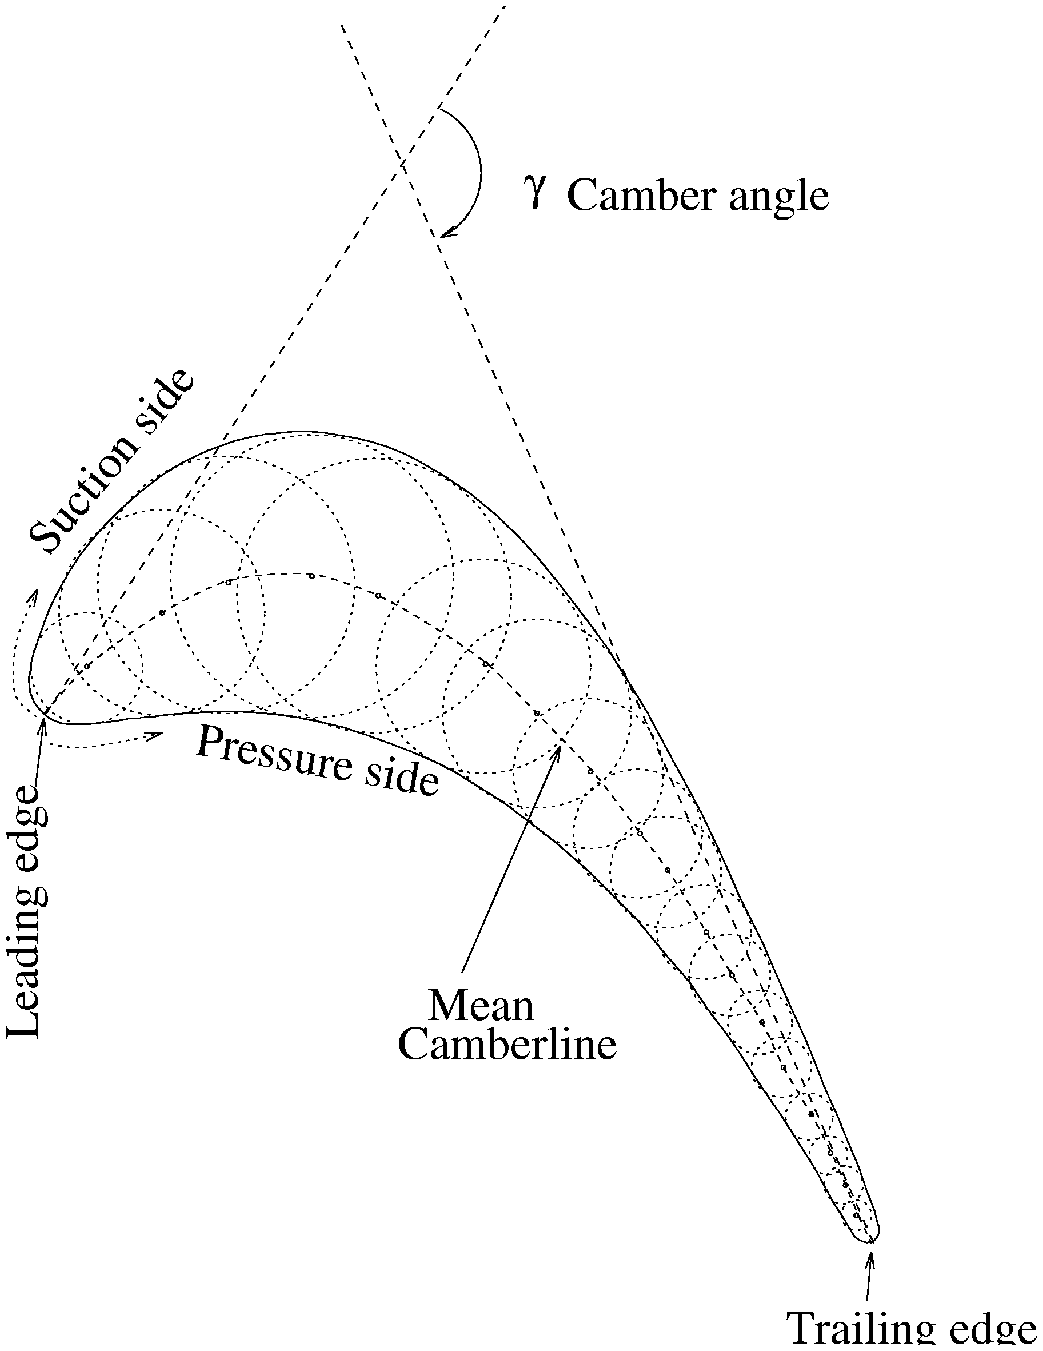
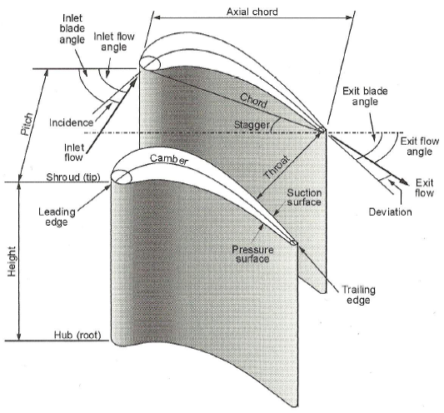
6.2. Expansion cascade
Nomenclature:

Slide 6
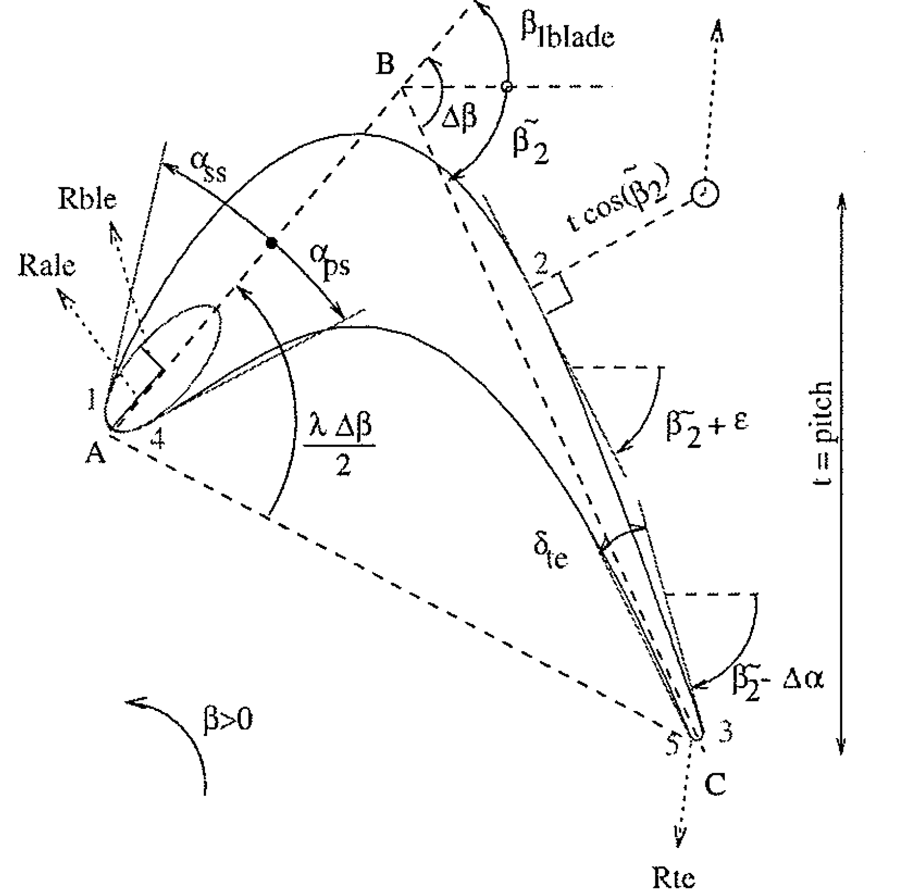
6.2. Expansion cascade
Definition:
Russian literature – atlas with profiles
Western literature – specific design
Multiple curves:
+ easy adjustment of the design parameters
Unique curve:
+ impose continuity in the curvature
+ flexibility increases with order
http://freespace.virgin.net/hugo.elias/graphics/x_bezier.htm
http://id.mind.net/~zona/mmts/curveFitting/bezierCurves/bca2/Bezier1Animation2.html
6
Notes:
Espesor de salida, depende de razones estructurales (erosión en turb. de vapor, que me lo complete Guillermo)
Momentos de inercias, debido a razones estructurales, sobretodo esfuerzos cortantes por el efecto de la rotación.

Slide 7
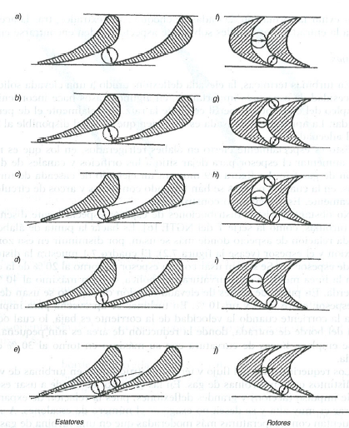
6.2. Expansion cascade
Definition:
7
Notes:
Espesor de salida, depende de razones estructurales (erosión en turb. de vapor, que me lo complete Guillermo)
Momentos de inercias, debido a razones estructurales, sobretodo esfuerzos cortantes por el efecto de la rotación.

Slide 8
Table of contents
6.1. Introduction
6.2. Expansion cascade
6.3. Loss correlations: Traupel
6.4. Loss correlations: Ainley y Mathieson
6.5. Loss correlations: Soderberg
6.6. Efficiency definition

Slide 9
6.3. Loss correlations: Traupel
Types of losses:
Profile losses (pr)
Secondary flow losses (s)
Clearance losses (cl)
Others:
Additional losses (z)
Disc windage losses (R)
Ventilation losses (V)
Off-desing losses (off))
Traupel correlations:

Slide 10
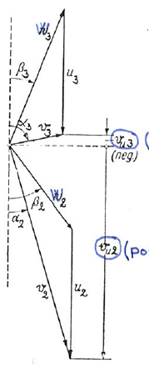
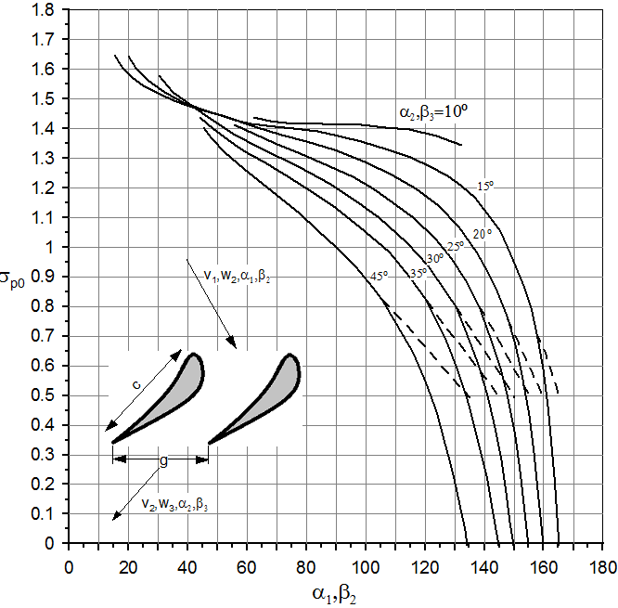
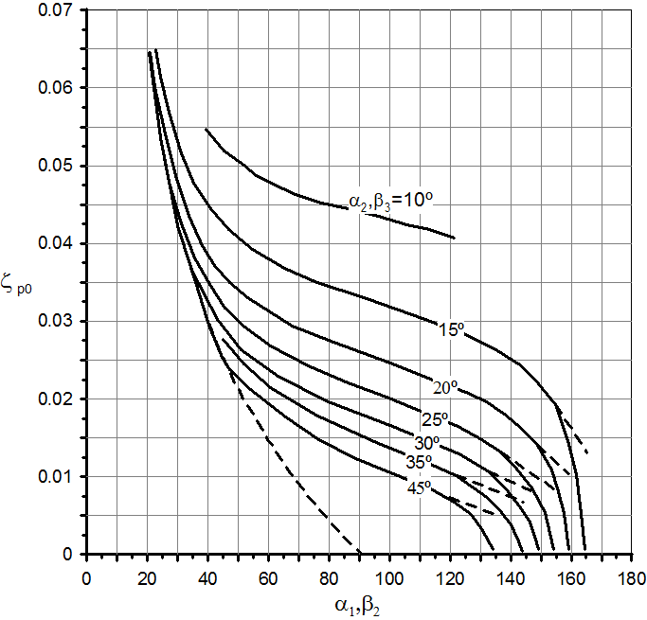
6.3. Loss correlations: Traupel
Profile losses
ς_{p0} : function of solidity (c/s) and design angles
Small c/s, risk of separation at high loading
High c/s, higher drag

Slide 11
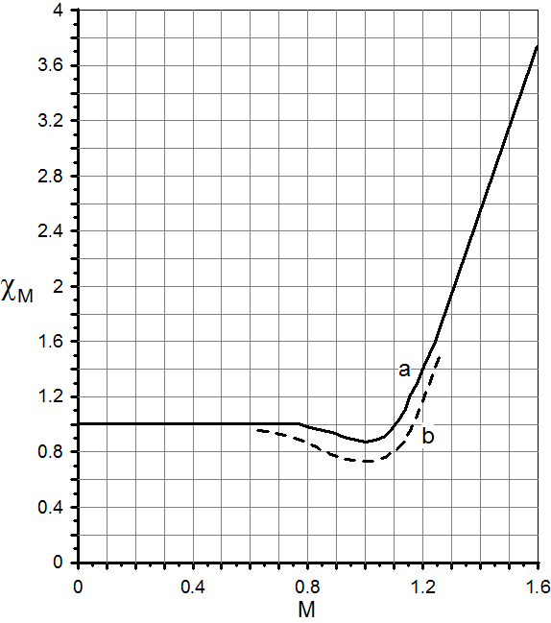
6.3. Loss correlations: Traupel
Profile losses
χ_{p} : Reynolds effect (defined as a function of chord and surface roughness) (↑Re → ↓χ_{p})
χ_{M} : Mach effect
Notes:
Xp en la figura del diagrama de moody del final

Slide 12
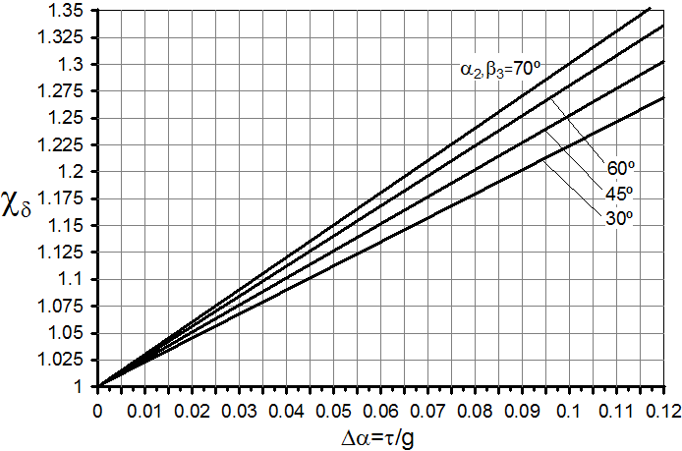
6.3. Loss correlations: Traupel
Profile losses
χ_{δ}, ς_{δ} : Trailing edge contribution

Slide 13
6.3. Loss correlations: Traupel
Profile losses
χ_{δ}, ς_{δ} : Trailing edge contribution
ς_{f} : For cylindrical airfoils, a correction for the variable incidence along span

Slide 14
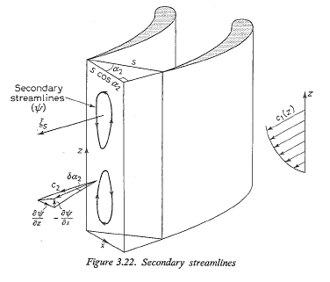
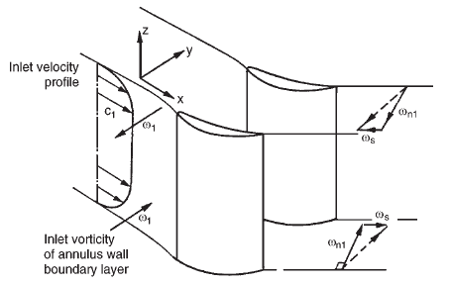
6.3. Loss correlations: Traupel
Secondary flow losses

Slide 15
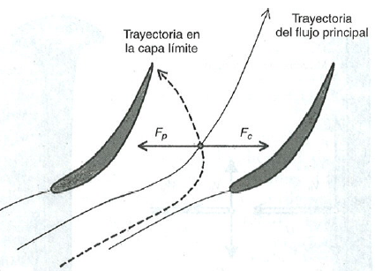
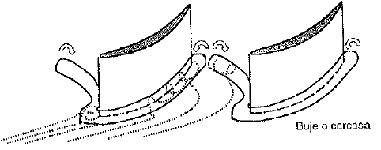
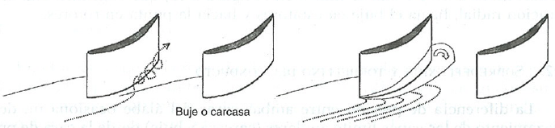
6.3. Loss correlations: Traupel
Secondary flow losses
Efecto tridimensional
15

Slide 16
6.3. Loss correlations: Traupel
Secondary flow losses
16

Slide 17
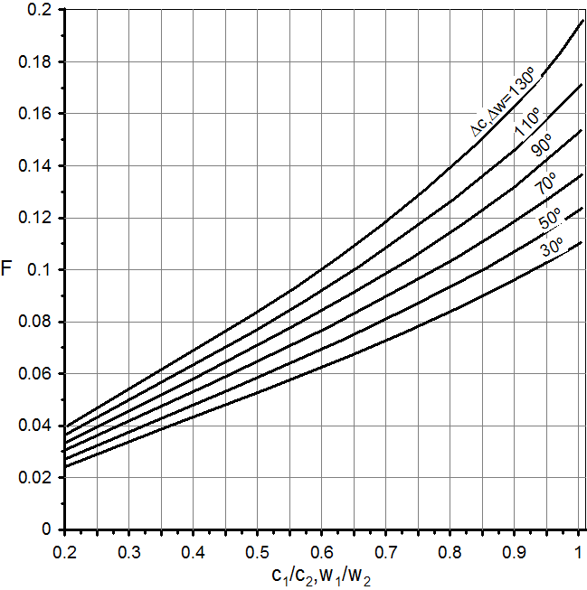
6.3. Loss correlations: Traupel
Secondary flow losses

Slide 18
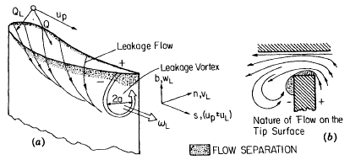
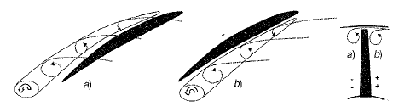
6.3. Loss correlations: Traupel
Clearance losses

Slide 19
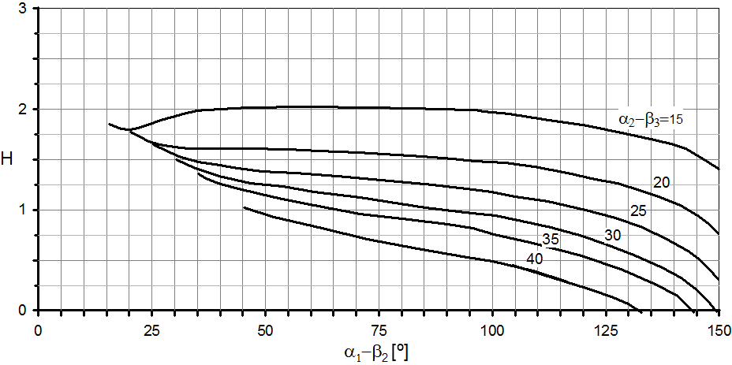
6.3. Loss correlations: Traupel
Clearance losses
Unshrouded blades
19

Slide 20
6.3. Loss correlations: Traupel
Clearance losses
Unshrouded blades

Slide 21
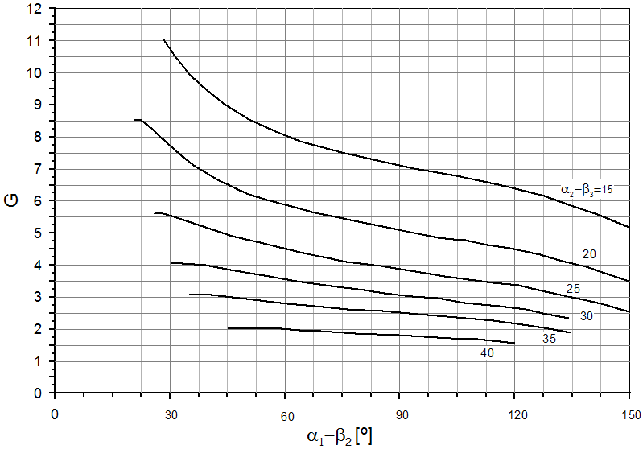
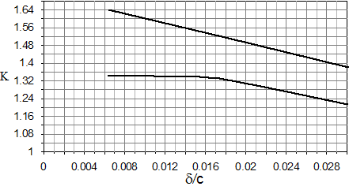
6.3. Loss correlations: Traupel
Clearance losses
Unshrouded blades

Slide 22
6.3. Loss correlations: Traupel
Clearance losses
shrouded blades
Pressure difference
Main flow - cavity

Slide 23
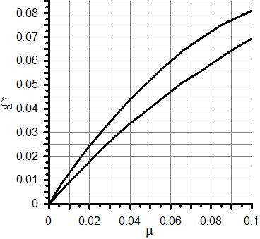
6.3. Loss correlations: Traupel
Clearance losses
shrouded blades

Slide 24
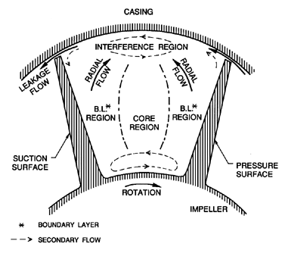
6.3. Loss correlations: Traupel
Clearance losses
shrouded blades

Slide 25
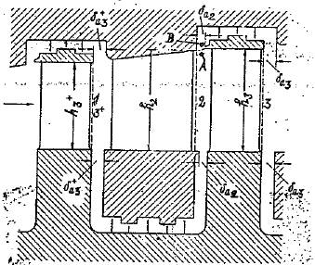
6.3. Loss correlations: Traupel
Additional losses
shrouded blades

Slide 26
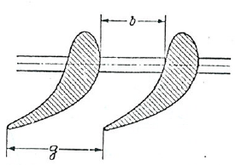
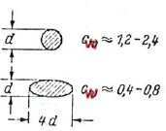
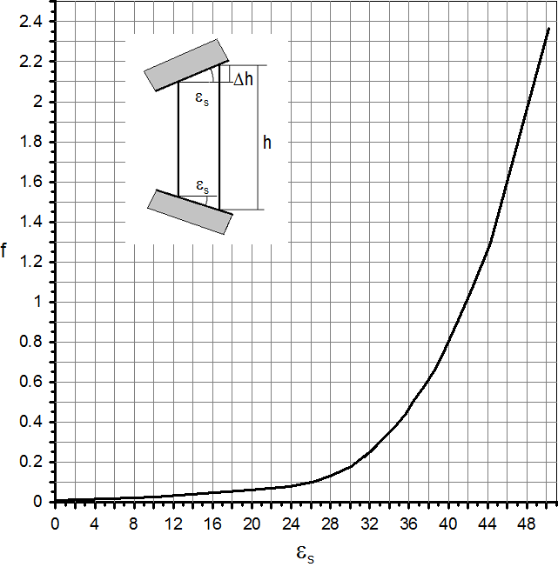
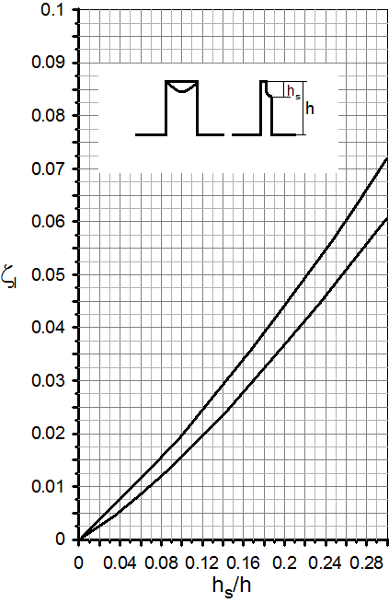
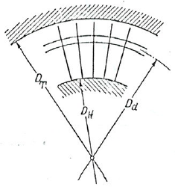
6.3. Loss correlations: Traupel
Additional
Lacing
Divergence
Sharpenning

Slide 27
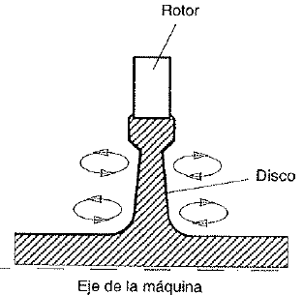
6.3. Loss correlations: Traupel
Disc windage
Friction on the lateral wall of the discs

Slide 28
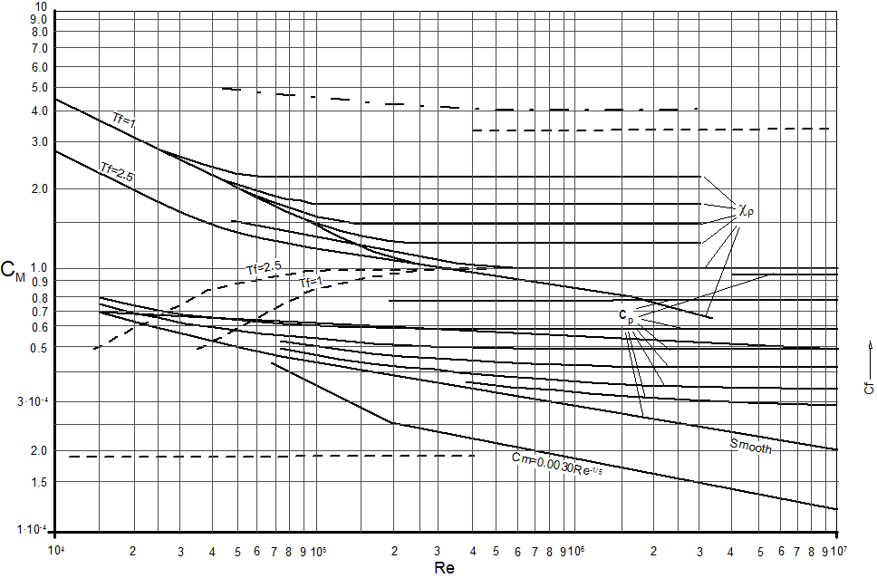
6.3. Loss correlations: Traupel
disc windage
Friction coefficient
28

Slide 29
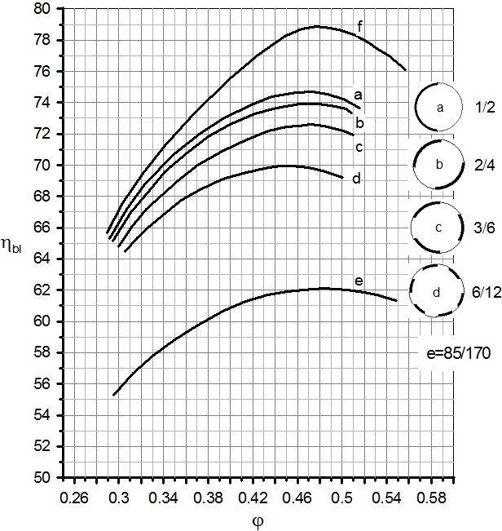
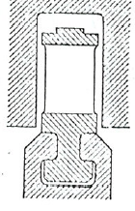
6.3. Loss correlations: Traupel
Ventilation
Partial admission

Slide 30
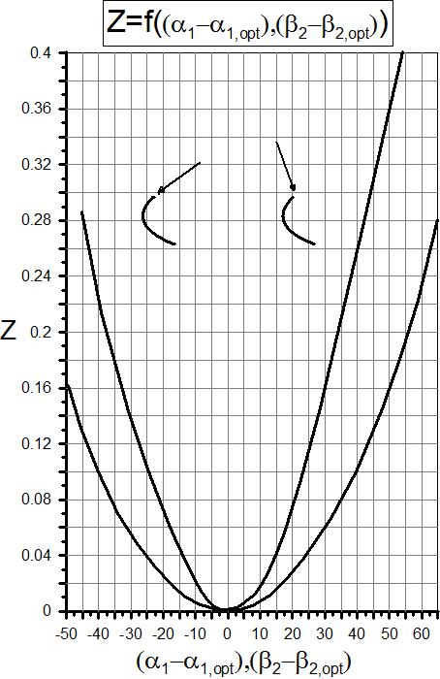
6.3. Loss correlations: Traupel
Off-desing losses
Insensitives to
variation in angle
b.-thin airfoils
Los escalonamientos con elevada aceleración tienen un rango de operación más amplio
b
a

Slide 31
Table of contents
6.1. Introduction
6.2. Expansion cascade
6.3. Loss correlations: Traupel
6.4. Loss correlations: Ainley y Mathieson
6.5. Loss correlations: Soderberg
6.6. Efficiency definition

Slide 32
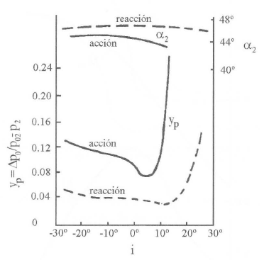
6.4. Loss correlations: Ainley y Mathieson
Ainley used the following coefficients:
In compresible flows
In 1951 Ainley y Mathieson proposed a methodology
to evaluate the pressure loss and outlet angle
Incompresible

Slide 33
6.4. Loss correlations: Ainley y Mathieson
Profile loss

Slide 34
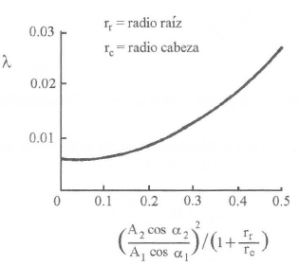
6.4. Loss correlations: Ainley y Mathieson
Secondary flow losses
The losses due to secondary flows:
For airfoils with low aspect ratio:

Slide 35
6.4. Loss correlations: Ainley y Mathieson
Leakage losses
Depend of the loading factor Z defined by Ainley, and the size of the cavity (K).
Dunham y Came introduced a correction to consider the aspect ratio:
B is 0.5 for shroudless designs, and 0.25 for unshrouded

Slide 36
Table of contents
6.1. Introduction
6.2. Expansion cascade
6.3. Loss correlations: Traupel
6.4. Loss correlations: Ainley y Mathieson
6.5. Loss correlations: Soderberg
6.6. Efficiency definition

Slide 37
6.5. Loss correlations: Soderberg
Soderberg found that for turbine rows with optimal solidity as given by Zweifel, Re=10⁵, h/c=3, the loss is exclusive function of the flow turning
At e_{max} (max hickness)/c=0.2:
At zero incidence the deviation is negligible:

Slide 38
6.5. Loss correlations: Soderberg
At a different aspect ratio h/C one can use:
b=ccosλ (λ.- stagger angle)
Reynolds correction:
Reynolds based on the hidraulic diameter:
Comparison Ainley-Mathieson vs. Soderberg:

Slide 39
Table of contents
6.1. Introduction
6.2. Expansion cascade
6.3. Loss correlations: Traupel
6.4. Loss correlations: Ainley y Mathieson
6.5. Loss correlations: Soderberg
6.6. Efficiency definition

Slide 40
6.6. Efficiency definition
Horlock expression
40
Notes:
Indicarles también que el grado de reacción óptimo es 0.5, aunque el rendimiento varía poco en torno a este valor. Lo mismo sucede con el factor de flujo, cuyo óptimo está en 0.5. Si lo aumentamos, aumentaría el trabajo específico, pero también se aumentan las inestabilidades. Con estos valores, el coeficiente de carga óptimo sería el obtenido con Deq sobre 1.95-2.

Slide 41
6.6. Efficiency definition
Horlock expression
41
Notes:
Indicarles también que el grado de reacción óptimo es 0.5, aunque el rendimiento varía poco en torno a este valor. Lo mismo sucede con el factor de flujo, cuyo óptimo está en 0.5. Si lo aumentamos, aumentaría el trabajo específico, pero también se aumentan las inestabilidades. Con estos valores, el coeficiente de carga óptimo sería el obtenido con Deq sobre 1.95-2.

Slide 42
6.6. Efficiency definition
Horlock expression
42
Notes:
Indicarles también que el grado de reacción óptimo es 0.5, aunque el rendimiento varía poco en torno a este valor. Lo mismo sucede con el factor de flujo, cuyo óptimo está en 0.5. Si lo aumentamos, aumentaría el trabajo específico, pero también se aumentan las inestabilidades. Con estos valores, el coeficiente de carga óptimo sería el obtenido con Deq sobre 1.95-2.

